Slide 1

Global Health
Carbon Footprint Simulation

Slide 2
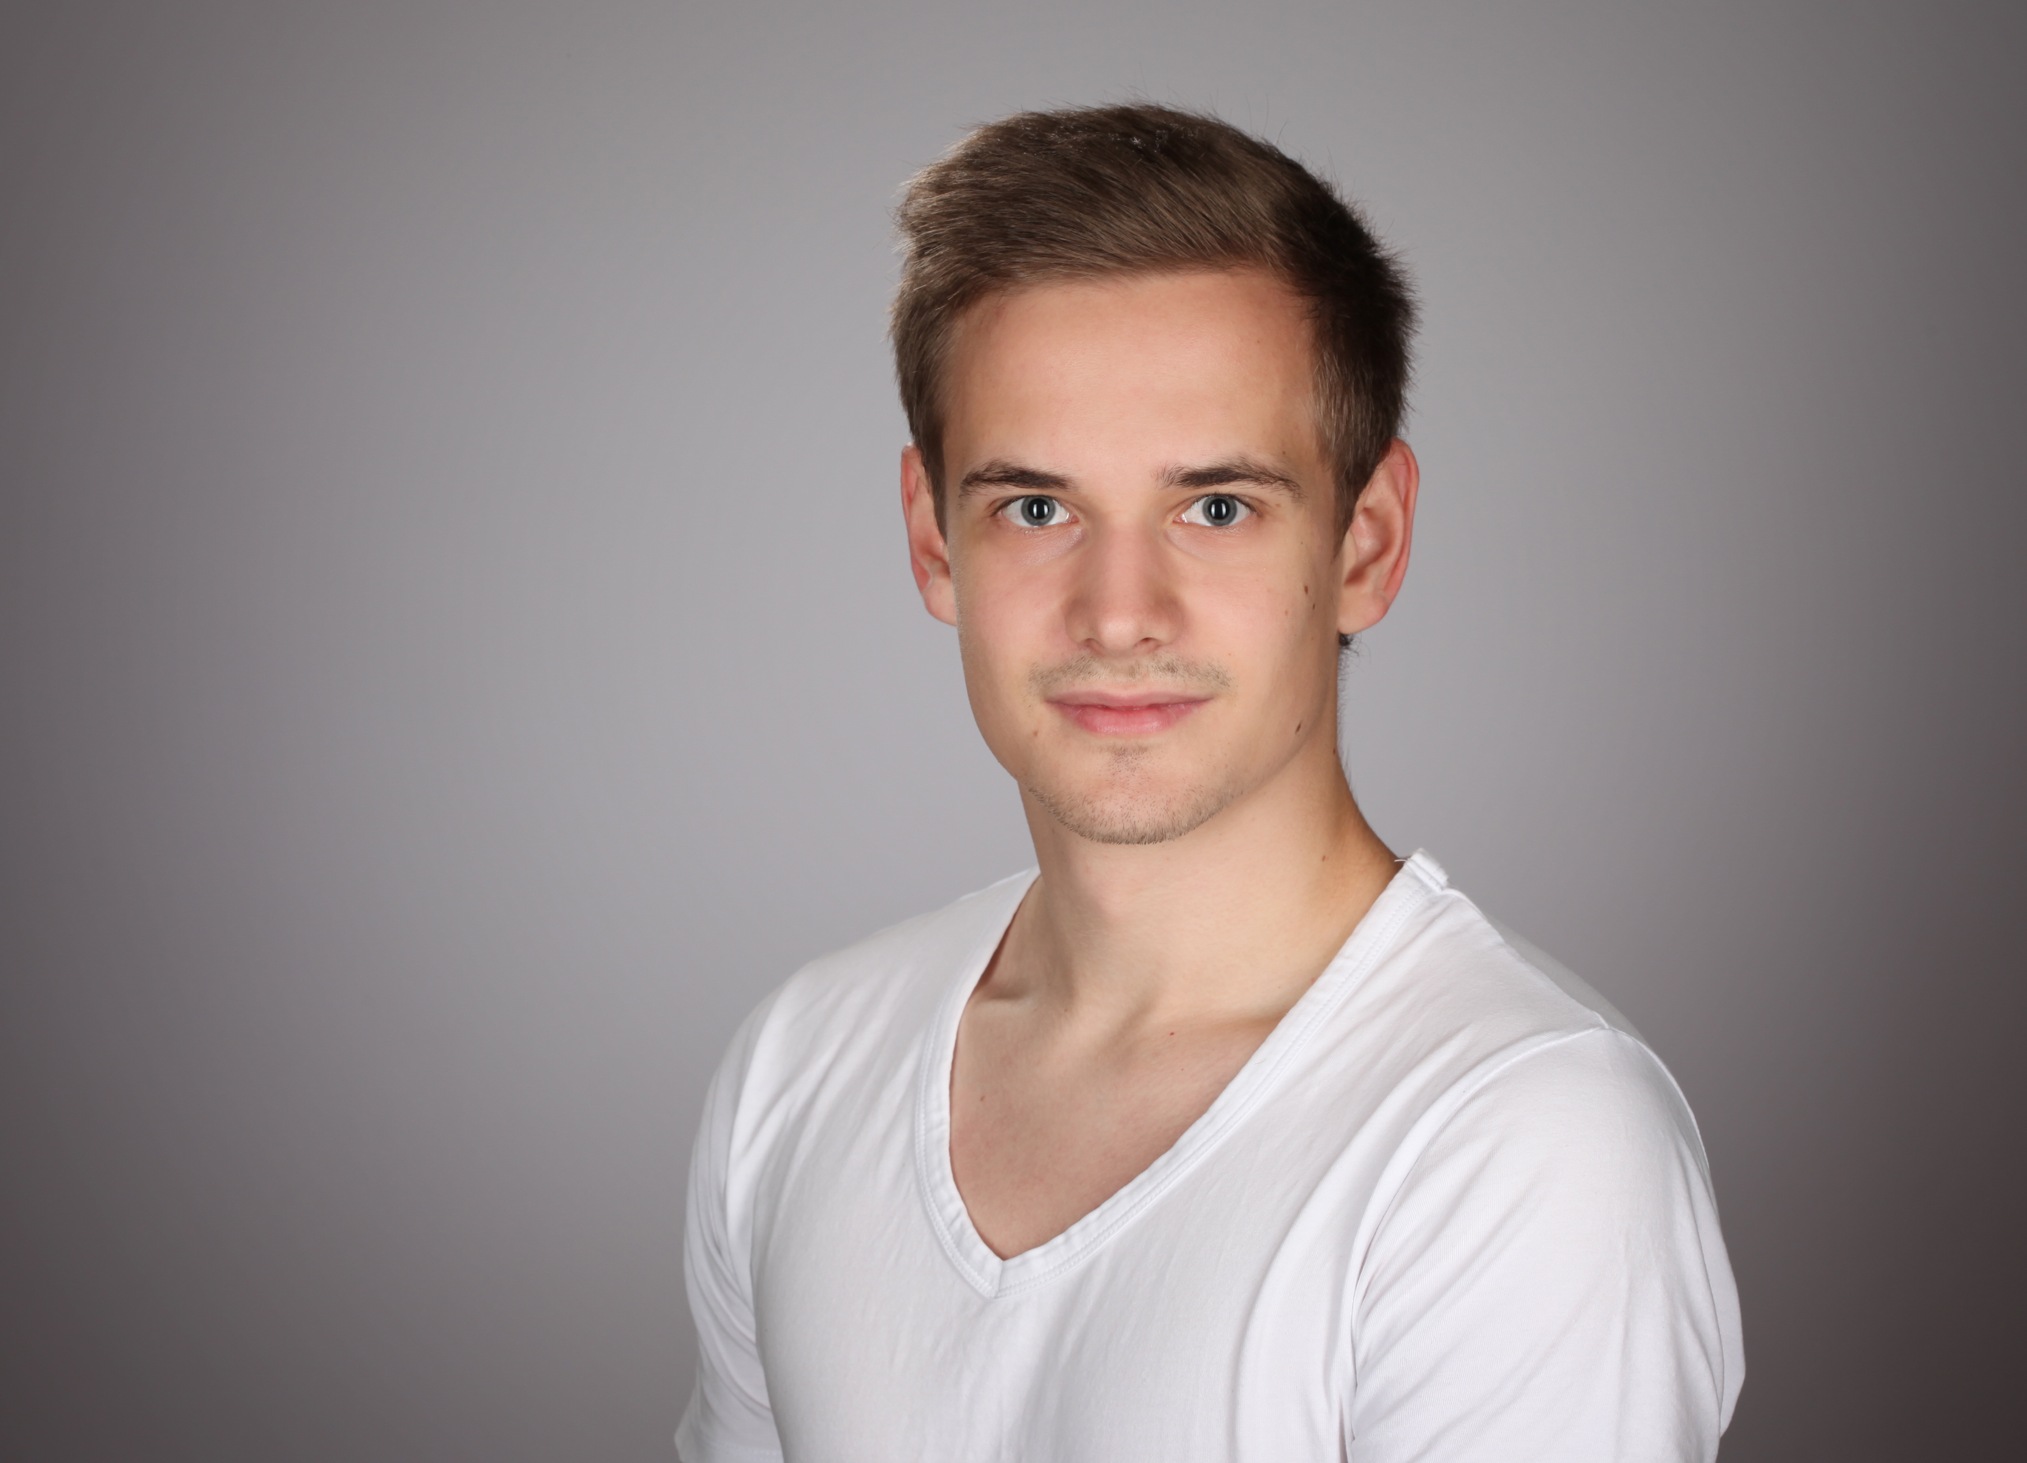

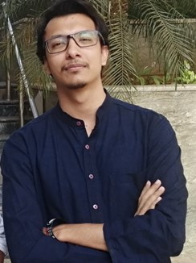
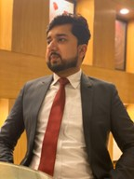

Team Climateers
Jonathan Denzler
International Information System
Florian Enders
International Information System
Samarth Kumar
Artificial Intelligence
Muhammad Bilal
Medical Engineering
Saikeerthi
Chirumamilla Hagadur
Artificial Intelligence
Notes:
Will be using Kanban board to create and manage tasks
Responsibilities
Developers:
Jonathan, Samarth
Researcher:
Muhammad
3D Asset Designer
Saikeerthi
Audio Designer
Florian
UX Designer
Shared

Slide 3
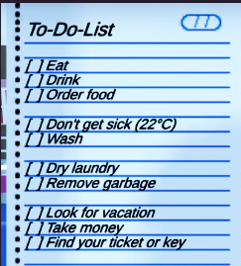
Vision
To help the users visualize the impact of their everyday actions on climate change
Simulate a day in the life of the player¹ and scale the actions to every person on the planet
A more realistic and intuitive approach than online carbon footprint calculators
While staying true to actual statistical values
Evaluate psychological effect of the game on participants
Uninterrupted immersive first-person experience
Keeping true to the single scene of the house
^{*1 - Simple to do list}
Notes:
Change room depending on actions
Catastrophe warnings on phone/tv
Son/Daughter to show impact on future generations
Picture, phone calls
mosquito nets appearing, you can hear buzzing if going near windows
research must be linked, though, all these ideas must have a foundation

Slide 4
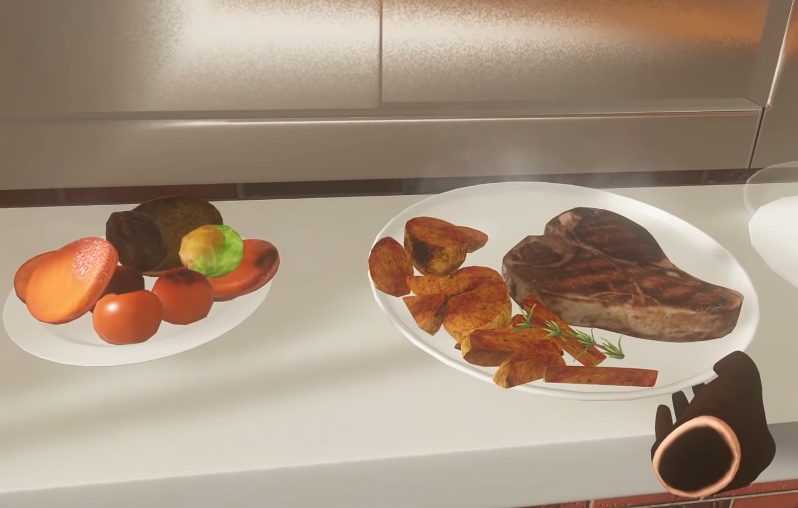
Research
Building on a Bachelor's Thesis - "CO2 footprint simulation with Unity" by Manuel Schildknecht²
Use of VR for greater immersion and realism. (greater psychological effect on user)
Alternatively: Mobile app for better accessibility
More focus on how changes in diet can affect the climate³
Continuous feedback instead of just at the end
The user will feel the need to improve their decisions as they progress
Limited target audience (based on age, education, hardware)
³ User is given a choice of food
²Thesis Research Paper - CO2-Fußabdruck Simulation mit Unity (17 May 2020) - https://www.studon.fau.de/file4822820_download.html
³ Screenshot from VR Game called Cooking Simulator

Slide 5
Roadmap
Vision
Align on basic vision, finish research
Theory
Finish on theory, get data regarding impact, path way for development
Development
Creating first prototype
Evaluation
Get people to use it, get evaluation
Adjustments
Report
Incorporate feedback
Present findings
~08.11.2022
~20.11.2022
15.12.2022
~07.01.2023
19.01.2023
09.02.2023
Notes:
Research & Vision: Read papers, identify gaps, etc. and finalize vision
Development: finding assets, creating some prototypes, animations, scripting, sound, analyzing & calculating statistics
Evaluation: Create a questionnaire, look for participants, measure effects of game

Slide 6
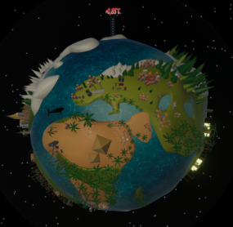
Open Discussions
Good/Bad changes in the apartment depending on actions.
Catastrophe warnings on radio/tv.
Son/Daughter to show impact on future generations.
Picture, phone calls.
A model of Earth outside the window to see how it is affected with your decisions.⁴
Changes in sea level, melting polar ice caps, Ozone layer depletion, pollution, etc.
⁴Earth-view
Notes:
Son/daughter:
Beginning of game she either stands in the room (might be hard to implement convincingly) or a task might be to pick her up from kindergarden or sth
Then in the “Bad case” where she dies, the task could simply disappear and a small shrine/picture remembering her shows up on a tabletop or sth
-> is not direct feedback, but rather inclines the user to “explore” the room a bit
-> i think this is a really cool approach if you are looking for what your actions did rather than ‘BAM’-being presented the repercussions of what you did

